Slide 1
Unit 4
LASER PHYSICS
-Neelima Patil

Slide 2
HISTORY & THE DISCOVERY
The maser which is the predecessor of the laser was first built in 1953.
First work done on laser was started in 1957 by Charles Hard Townes and Arthur Leonard at Bell labs.
T.H.Maiman built the first laser device in 1960. It is one of the most influential technological achievements of the 20 ^{th} century.
In 1961, A. Javan and associates developed the first gas laser, the helium-neon laser.

Slide 3
INTRODUCTION
LASER is an acronym for:
L : Light
A : Amplification ( by)
S : Stimulated
E : Emission (of)
R : Radiation
Term coined by Gordon Gould.
It is an optical device which emits highly coherent, monochromatic beam of light with high directionality and extreme brightness.

Slide 4
Characteristics of Laser light
1 Laser light is restricted to single wavelength called monochromatic
2 It is highly coherent i. e. waves coincides in space and time
3 It has very high directionality(less divergence).
4 It is extremely bright which carries very large amount of energy.

Slide 5
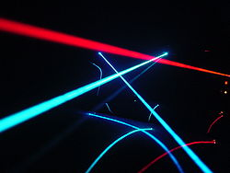
LASER BEAM

Slide 6
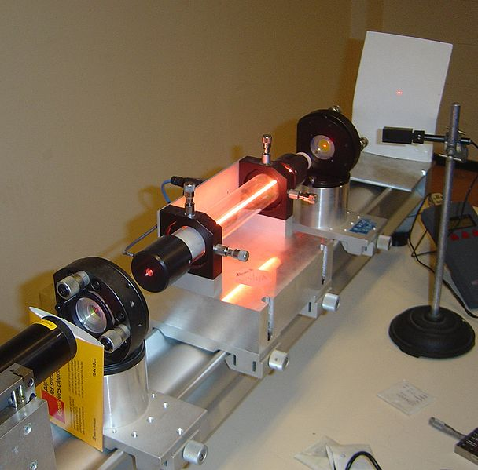
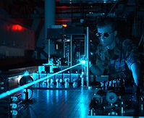
LASER BEAM APPARATUS
7

Slide 7
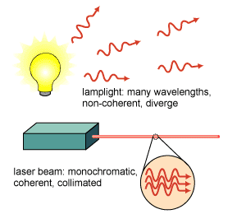
Laser and Ordinary light

Slide 8
INTERACTION OF LIGHT WITH MATTER
THE THREE QUANTUM PROCESSES :
1) Stimulated Absorption
2) Spontaneous emission and
3) Stimulated emission.

Slide 9
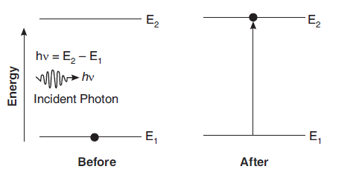
INTERACTION OF LIGHT WITH MATTER
1) Stimulated Absorption:
N₂
Each transition may be represented as
A + hν → A*
A= an atom in lower state
A*= excited atom
N₁
The number of atom N_{ab} excited during the Δt is given by
N_{ab}=B₁₂N₁QΔt

Slide 10
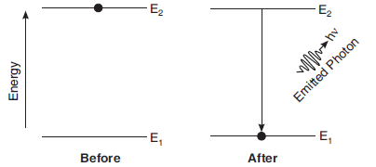
2) Spontaneous Emission- Cannot be used in light amplification and results in ordinary light
INTERACTION OF LIGHT WITH MATTER
Each transition may be represented as
A* → A + hν
A*= excited atom
A= an atom in lower state
The number of spontaneous transitions N_{sp} taking place in the material during the Δt is independent of the photons present in the incident radiation and depends only on the number of atoms N2 lying in E2, given by
N_{sp}=A₂₁N₂Δt

Slide 11
Spontaneous Emission
INTERACTION OF LIGHT WITH MATTER
The instant of transition(This refers to the exact moment when an atom or molecule changes from one energy state to another, typically through the emission or absorption of a photon), direction of emission of photon(angle or direction in which the photon is emitted after the transition), the phase of the photon, the polarization state of the photon(orientation of the electric field vector of the photon.) are all random quantities.
The light generated by the medium will be incoherent
Radiated light is in the form of short wave trains emitted in all directions. (series of waves traveling together)

Slide 12
Cannot be used in light amplification and results in ordinary light.
Spontaneous Emission

Slide 13
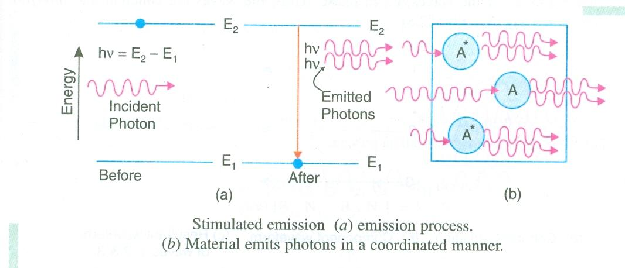
3) Stimulated Emission
INTERACTION OF LIGHT WITH MATTER
Each transition may be represented as
A* + hν → A+ 2 hν
A= an atom in lower state
A*= excited atom
The number of stimulated transitions N_{st} occurring in the material during the Δt may be given by
N_{st}=B₂₁N₂QΔt

Slide 14
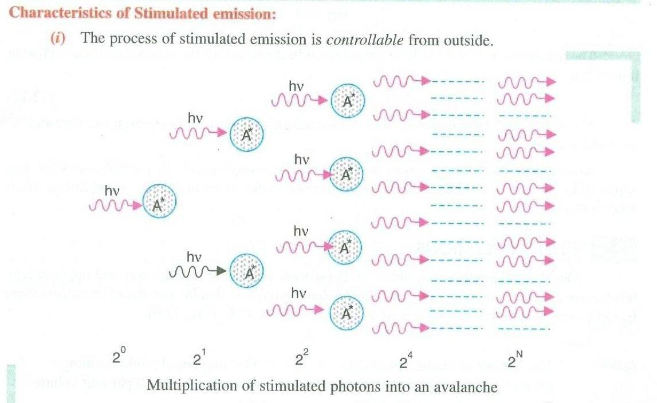
Stimulated Emission-results in amplification of light
INTERACTION OF LIGHT WITH MATTER

Slide 15
Simtulated Emission
INTERACTION OF LIGHT WITH MATTER
Characterized by some very important features:
Emitted and incident(stimulating) photon(both are propagated in the same dirn.) is identical in all respects as Frequency, Phase, Direction
The process is controllable from outside
Multiplication of photons takes place
The number of photons builds up in avalanche-like manner
It suggests that electromagnetic waves of extremely high amplitude could be generated by the stimulated emission leading to amplification of light
The process of stimulated emission is the key to the operation of a laser.

Slide 16
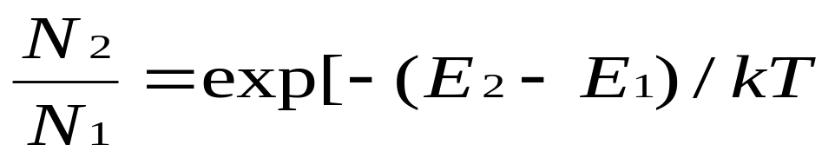
Population and Thermal Equillibrium
In a state of thermal equillibrium, the populations of energy levels E2 and E1
are fixed given by the Boltzmann distribution function
N₁ = e^{-E1/kT} ⁻⁻⁻⁻⁻⁻⁻⁻⁽¹⁾
N₂ = e^{-E2/kT} ₋₋₋₋₋₋₋₋₋₋₍₂₎
The population ratio N₂/N₁ is given by
N₂/N₁= e^{- hv/kT}
Negative sign indicates N2 << N1

Slide 17
Population and Thermal Equillibrium
Thus, in thermal equilibrium, the lower energy state is more populated than the higher energy state.
● As T increases, the number of atoms in the higher energy state (N₂) increases, but N₂ never exceeds N₁ for a system in thermal equilibrium.
● If T---> ∞ , then N₂/N₁ = e⁰ = 1. Therefore N₂=N₁
This shows that at infinite temperature also the populations N₂ and N₁ become equal.
If (E2-E1)→ 0, N₂/N₁= e⁰ =1
From equation N₂/N₁= e^{- hv/kT} we can draw conclusions:
1. In other words, a population inversion (N₂/N₁>1) can never exist for a system at thermal equilibrium.
2. The relative population N₂/N₁ depends on the temperature T.
3. Also, it depends on the energy difference (E₂-E₁)

Slide 18
Population and Thermal Equillibrium
Basic concepts:
Population inversion: It is a state of achieving more number of atoms in excited state compared to ground state. It is an essential condition for producing laser beam.
Life time: The limited time for which an atom remains in the excited state is known as lifetime.
Metastable state: It is an energy level in an atomic system where the lifetime of atoms is very large of the order of 10⁻⁶ to 10⁻³ seconds. It helps in achieving population inversion.
Lasing: The process which leads to emission of stimulated photons after establishing the population inversion is referred as lasing.

Slide 19
Light Amplification
In thermal equilibrium, the number of upward transitions is equal to the number of downward transitions. Thus,
N_{ab}=N_{sp} +N_{st}
B₁₂N₁ ρ(ν) = A₂₁N₂ + B₂₁N₂ ρ(ν)
where B₁₂, B₂₁ and A₂₁ are called the Einstein’s Coefficients
Light amplification requires that stimulated emission occur almost exclusively.
In practice, absorption and spontaneous emission always occur together with stimulated emission.
The laser operation is achieved when stimulated emission exceeds in a large way the other two processes.

Slide 20
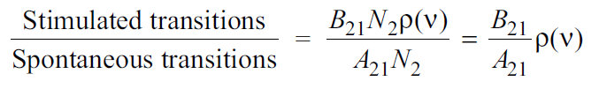
Light Amplification
Condition for Stimulated Emission to Dominate Spontaneous Emission:
1) The Ratio
Stimulated transitions will dominate the spontaneous transitions if the radiation density ρ(ν) is very large. Thus, the presence of a large number of photons in the active medium is required. However, it will lead to more absorption transitions.
Large photon density alone will not guarantee more stimulated emissions.
2) Requirement of States of Larger Lifetimes: Stimulated transitions will dominate the spontaneous transitions if the value of the ratio B₂₁/A₂₁ is also large.
To increase the probability of stimulated emissions, the lifetime of atoms at the excited state should be larger.
In other words, it is necessary that the excited state has a longer lifetime (remember that 1/A₂₁ represents the lifetime of the excited state)

Slide 21

Light Amplification
Condition for Stimulated Emission to Dominate Absorption Transitions:
The ratio
The above condition indicates that the stimulated transitions will overwhelm the
absorption process if N₂ is greater than N₁.
It means that there should be more atoms present in the higher energy level than in the lower energy level.
Therefore to achieve high percentage of stimulated emissions, an artificial situation known as population inversion is to be created in the medium.
A medium amplifies light only when the above three conditions are fulfilled.

Slide 22
Light Amplification
MEETING THE THREE REQUIREMENTS
I) Population Inversion:
Population inversion is the condition of the material in which population of the upper energy level N₂ far exceeds the population of the lower energy level, N₁. That is, N₂ >> N₁
In this condition the population distribution between the levels E₁ and E₂ is inverted and
hence it is known as the inverted state.
This is a non-equilibrium state and exists only for a short time.
Population inversion is obtained by employing pumping techniques, which transfer large number of atoms from lower energy level to higher energy level.
Pumping is a process of exciting and lifting atoms from lower energy state to higher energy state by means of external energy given to the particles.
The most common methods of pumping are optical pumping, electrical pumping and direct conversion pumping.

Slide 23
Light Amplification
Pumping Schemes:
Optical pumping: In this type of pumping atoms are excited by means of an external optical source. This type of pumping is adopted in solid state lasers set as Ruby and Nd: YAG laser.
2) Electrical pumping: A high voltage pulse initially ionizes the gas so that it conducts
electricity. An electric current flowing through the gas excites atoms to the excited level from where they drop to the metastable level leading to population inversion. This technique is adopted in gas lasers such as He Ne laser CO₂ laser.
3) Direct conversion pumping: In this type a direct conversion of electric energy into to light tales place. This technique is adopted in semiconductor laser.

Slide 24
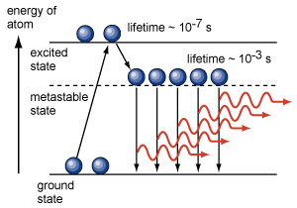
Light Amplification
II) Metastable States:
To establish the condition of population inversion, the excited atoms are required to ‘wait’ at the upper energy level till a large number of atoms accumulate at that level. This is achieved by metastable states.
Atoms excited to a metastable state remain excited for an appreciable time, which is of the order of 10^{–6} to 10^{–3}s.
It would be impossible to create the state of population inversion without a metastable state.
Metastable state can be readily obtained in a crystal system containing impurity atoms.
These levels lie in the forbidden band gap of the host crystal.

Slide 25
Light Amplification
III) Confining Radiation within the Medium:
A high radiation density ρ(ν) is required to be present in the active medium so that stimulated emission dominates spontaneous emission.
If laser medium is enclosed in between a pair of optically plane parallel mirrors, photon density builds up to a very high value through repeated reflections of photons which remain within the medium.
Such an arrangement is known as an optical resonant cavity or optical resonator.

Slide 26
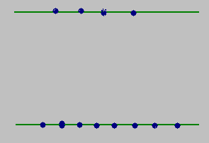
The Principal Pumping Schemes: Laser Operation
Two level system
Two level scheme is not generally feasible for laser action. The main reason is that the energy being used to pump the atoms into the upper laser state has an equal probability of
stimulating them back down. Therefore, it is not possible in general to pump more than half of atoms into the excited state.
According to Heisenberg uncertainty relation
ΔE x Δt > h/2π

Slide 27
The Principal Pumping Schemes: Laser Operation
Three level system
E₃
Fast transition
E₂
Laser action
E₁
Possible Transitions
E₁→E₃ Pumping
E₃→E₂ Spontaneous emission.
E₂→E₁ Stimulated emission.
Population inversion between states E₂ and E₁
State E₂ is a metastable state

Slide 28
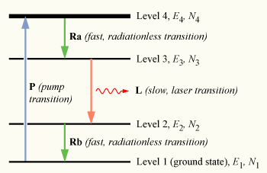
The Principal Pumping Schemes: Laser Operation
Four level system
Possible Transitions
E₁→E₄ Pumping
E₄→E₃ , E₂→E₁ spontaneous emission.
E₃→E₂ Stimulated emission.
Population inversion between states E₃ and E₂
State E₃ is a metastable state

Slide 29
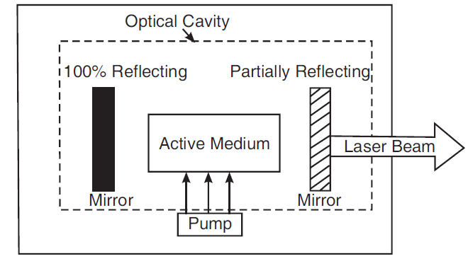
COMPONENTS OF LASER
The essential components of a laser are
(i) Active medium
(ii) Pumping agent and
(iii) Optical resonator

Slide 30
COMPONENTS OF LASER
(i) Active medium:
All types of atoms are not suitable for laser operation. Even in a medium consisting of different species of atoms, only a small fraction of atoms of a particular type have energy level system suitable for achieving population inversion.
Such atoms can produce more stimulated emission than spontaneous emission
and cause amplification of light. Those atoms, which cause laser action, are called active
centres.
The rest of the medium acts as host and supports active centres. The medium hosting
the active centres is called the active medium.
An active medium is a medium which when excited reaches the state of population inversion and promotes stimulated emissions leading to light amplification.
(ii) Pumping agent :
For achieving and maintaining the condition of population inversion, we have to raise continuously the atoms in the lower energy level to the upper energy level. It requires energy to be supplied to the system. Pumping is the process of supplying energy.

Slide 31
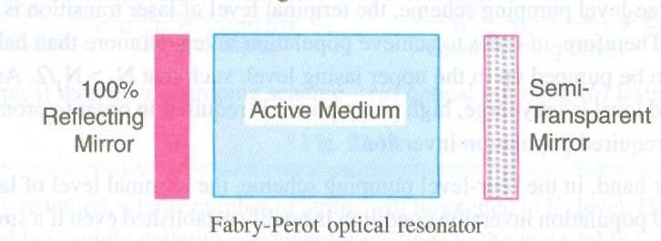
Optical Resonator

Slide 32

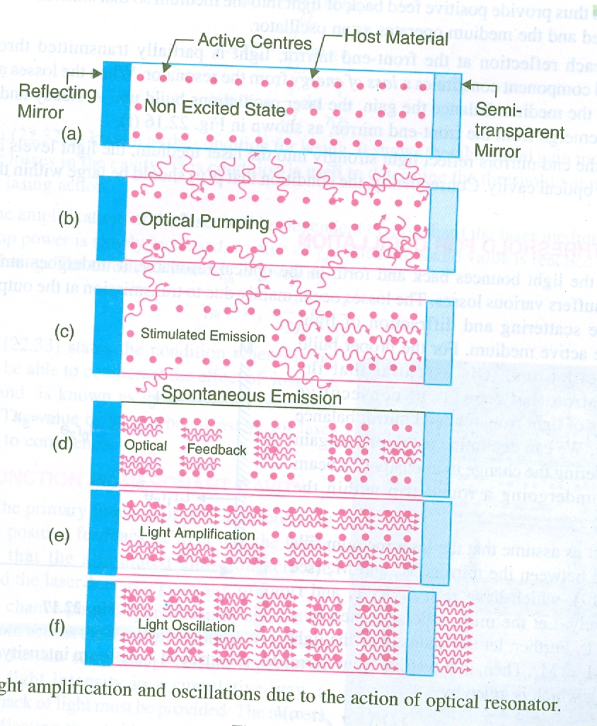
Optical Resonator

Slide 33
Ruby Laser
The first working laser was built in 1960 by my Maiman using a Ruby crystal so-called the
Ruby crystal. It is a solid state laser.
It works on the principle of 3 level pumping scheme and involves optical pumping to achieve
population inversion.
It works in a pulse mode.
Construction:
Active Medium: Ruby is basically Al₂O₃ crystal containing about 0.05% of chromium atoms. Cr³⁺ ions are the actual active centers while aluminum and oxygen atoms are inert.
Optical Resonator: Ruby rod is taken in the form of a cylindrical rod of about 4 cm in length and 1 cm in diameter. Its ends are grounded and polished such that the end faces are exactly parallel and are also perpendicular to the axis of the rod. The end faces of the ruby rod are silvered so that they form the optical resonator. The rear face is made totally reflecting while the front face is made partially reflecting.
Pumping agent: A helical photographic flash lamp filled with xenon. Whenever activated by the power supply the lamp produces flashes of white light.

Slide 34
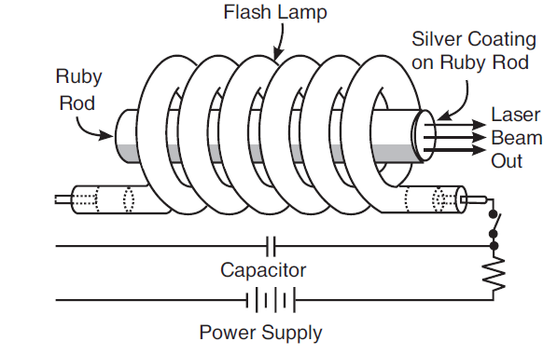
Ruby Laser

Slide 35
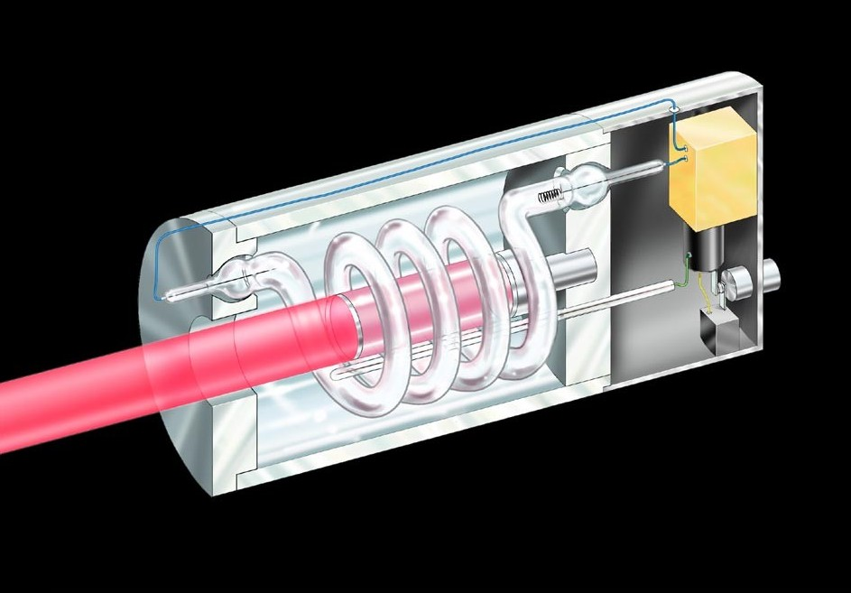
Ruby Laser

Slide 36
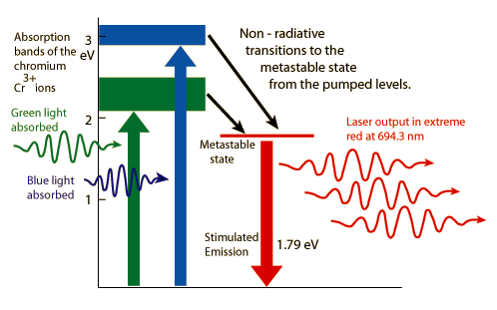
Ruby Laser

Slide 37
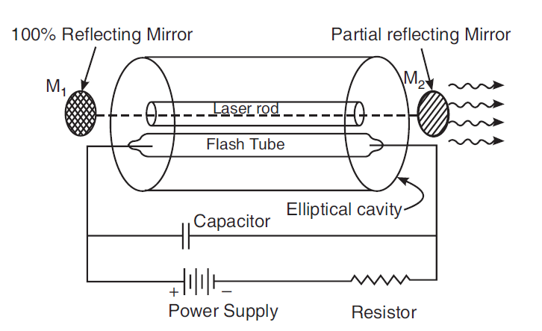
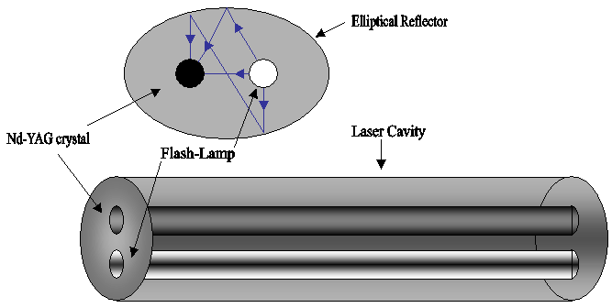
Nd:YAG Laser

Slide 38
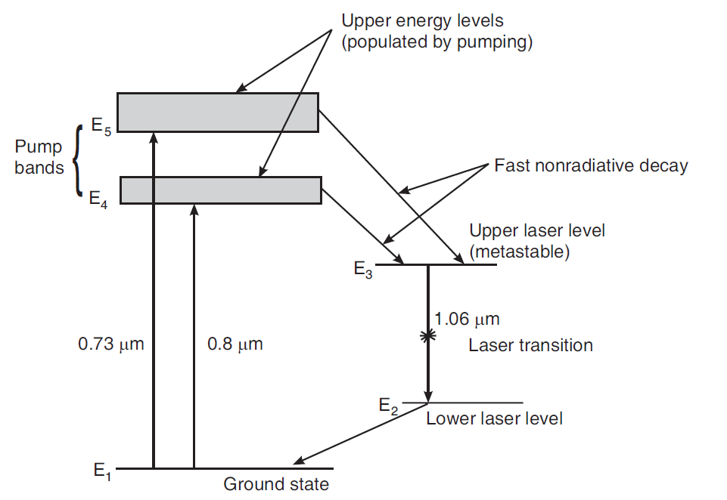
Nd:YAG Laser

Slide 39
GAS LASER: HELIUM-NEON LASER
Gas lasers operate with rarefied gases as the active media and are excited by an electric discharge. In gases, the energy levels of atoms involved in the lasing process are narrow and as such require sources with sharp wavelength to excite atoms. The most common method of exciting gas laser medium is by passing an
electric discharge through the gas. Electrons present in the discharge transfer energy to atoms in the laser gas by collisions. The first gas laser was He-Ne laser, which was invented in 1961 by Ali Javan, William R. Bennett, and Donald R. Herriott.
Construction:
Active medium: He-Neon laser consists of a long discharge tube filled with a mixture of helium and neon gases in the ratio 10:1. Neon atoms are the active centres and have energy levels suitable for laser transitions while helium atoms help in exciting neon atoms.
Optical Resonator: The tube is hermetically sealed by inclined windows arranged at its two ends. On the axis of the tube, two mirrors are arranged externally, which form the Fabry-Perot optical resonator. The distance between the mirrors is adjusted to be mλ/2 such that the resonator supports standing wave pattern.
Pumping Device: Electrodes are provided in the discharge tube to produce discharge in the gas. They are connected to a high voltage power supply.

Slide 40
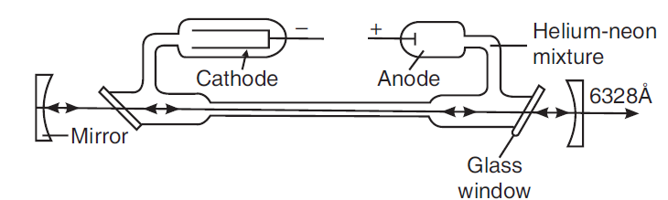
GAS LASER: HELIUM-NEON LASER

Slide 41
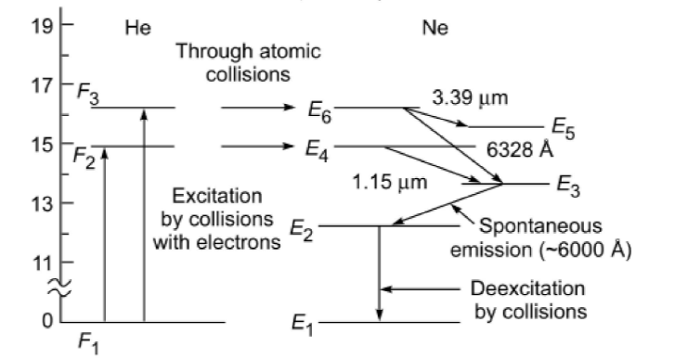
GAS LASER: HELIUM-NEON LASER
Working:
20.61 eV
20.66 eV
F₃ & F₂ : metastable states of He atoms
E₆ & E₄ : metastable states of Ne atoms
Possible laser Transitions:
E₆→ E₃ : Laser beam of wavelength 6328 Å
E₆→ E₅ : Laser beam of wavelength 33900 Å
E₄→ E₃ : Laser beam of wavelength 11500 Å

Slide 42
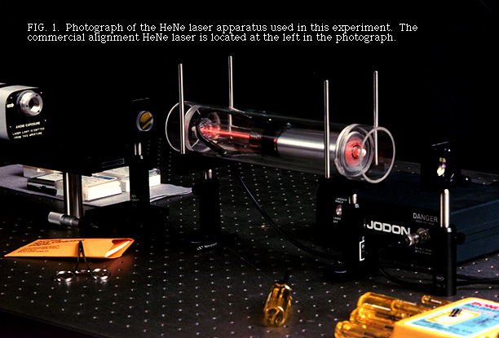
GAS LASER: HELIUM-NEON LASER

Slide 43
Semiconductor Diode Laser
Principle: When an electron from the conduction band jumps into a hole in the valence band, the excess energy, E_{g} is given out in the form of a photon. Thus, the electron-hole recombination is the basic mechanism responsible for emission of light in semiconductor diode laser. It works on the principle of direct conversion of electric energy to light energy.
Construction:
Active medium: Consists of a heavily doped n-type GaAs material. A p-region is formed on its top by diffusing zinc atoms into it. A heavily zinc doped layer constitutes the heavily doped p-region.
Pumping Device: An adequate forward bias is required to develop injection carriers across a junction to initiate a population inversion between energies at valance band and energies at conduction band.
Thus pumping is achieved via Forward diode current. The process is called injection pumping.

Slide 44
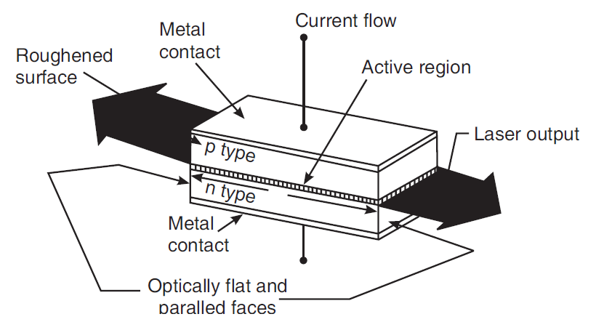
Semiconductor Diode Laser
Optical Resonator: Typical diode chips are 500 μm long and about 100 μm wide and
thick. The top and bottom faces are metalized and metal contacts are provided to pass current through the diode. The front and rear faces are polished parallel to each other and perpendicular to the plane of the junction. The polished faces constitute the Fabry-Perot resonator. The two remaining sides of the diode are roughened to eliminate lasing action in that direction. The entire structure is packaged in small case which looks like the metal case used for discrete transistors.

Slide 45
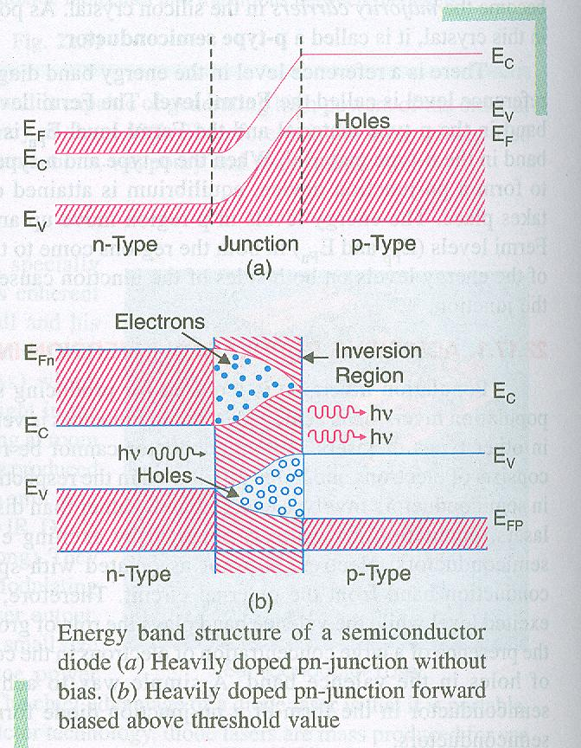
Semiconductor Diode Laser
Working:

Slide 46
Applications of Lasers
Laser light is different from an ordinary light. It has various unique properties such as coherence, monochromaticity, directionality, and high intensity. Because of these unique properties, lasers are used in various applications.
The most significant applications of lasers include:
Lasers in medicine
Lasers in communications
Lasers in industries
Lasers in science and technology
Lasers in military

Slide 47
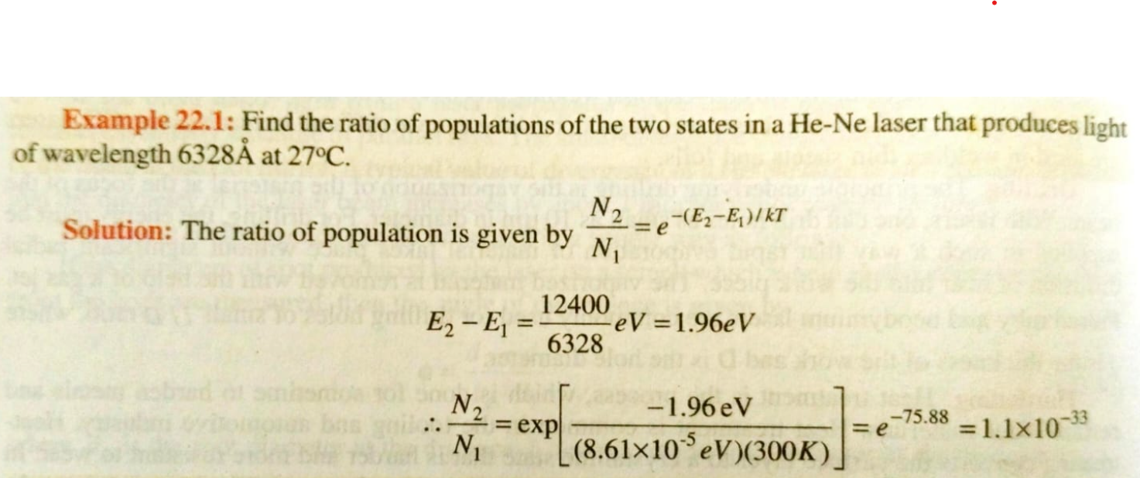

Slide 48
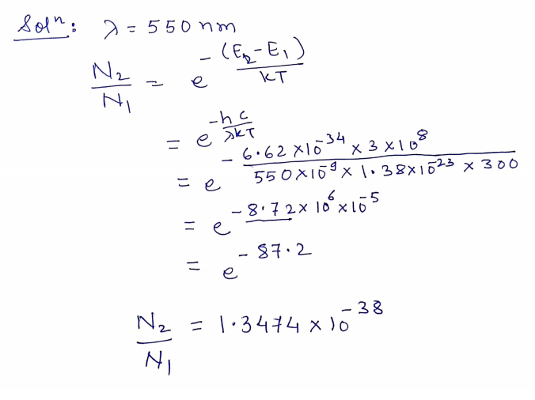
A three level laser emits laser light at a wavelength of 550 nm, if optical pumping mechanism is shut down what will be the ratio of population of upper level to that of lower level, (T = 300^{O}K).
Given (k= 1.38 x 10⁻²³ J/ºk, h = 6.62 X 10^{–34} J–Sec, c = 3 x 10⁸ m/s)

Slide 49
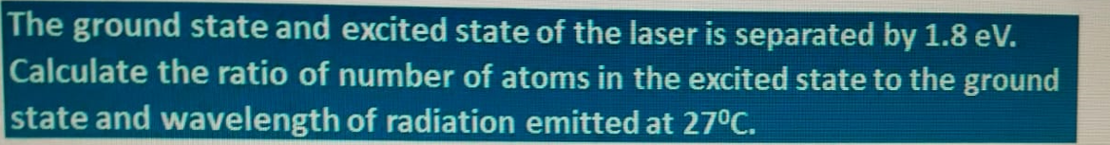
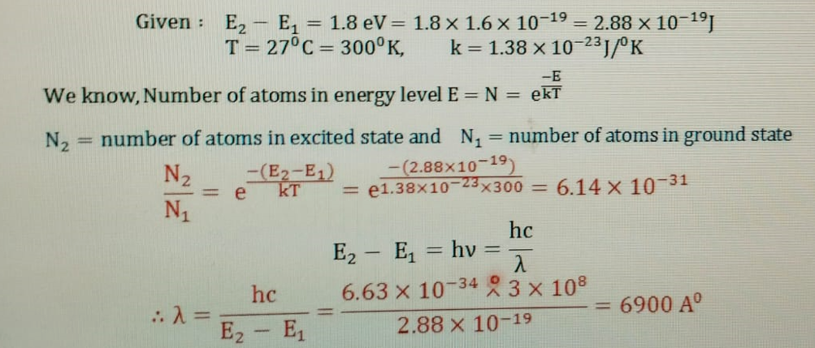

Slide 50
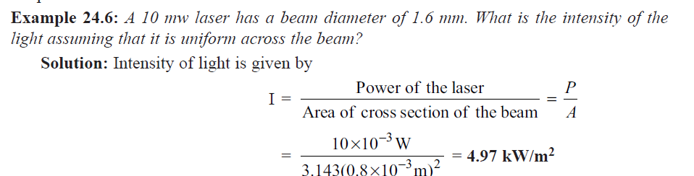
1) When a laser light emits radiation E₂ – E₁ = 2.36 eV, then the wavelength of emitted radiation is ………..( Given: h=6.63 x 10⁻³⁴Js)
a) 1243 nm b) 843 nm
c) 527 nm d) 176 nm

Slide 51
2) What is the ratio of population of two states in a Nd-YAG laser that produces light of wavelength 10640 Å at 300 K? a) 2.3 x 10⁻²⁰ b) 2.3 x 10⁻¹⁸ c) 2.3 x 10⁻²² d) 2.3 x 10⁻³⁶

Slide 52
Thanks !

